Slide 1

An intelligent system for the detection of ophthalmic features from color fundus photography Final Presentation
Team 6 from IS04, PSUPR

Slide 2
Our Team
Zhong Xiaohui
Kelvin Li Zhenghao
Zheng Xiaolan
Lim Chang Siang
Team Lead
Business Case
UI / UX designer
Machine Learning Engineer
Product Owner
Domain Expert
Data acquisition
Machine Learning Engineer
Technical Writer
Data analysis
Data processing
Machine Learning Engineer
Technical Lead
Full Stack Developer
Machine Learning Engineer

Slide 3
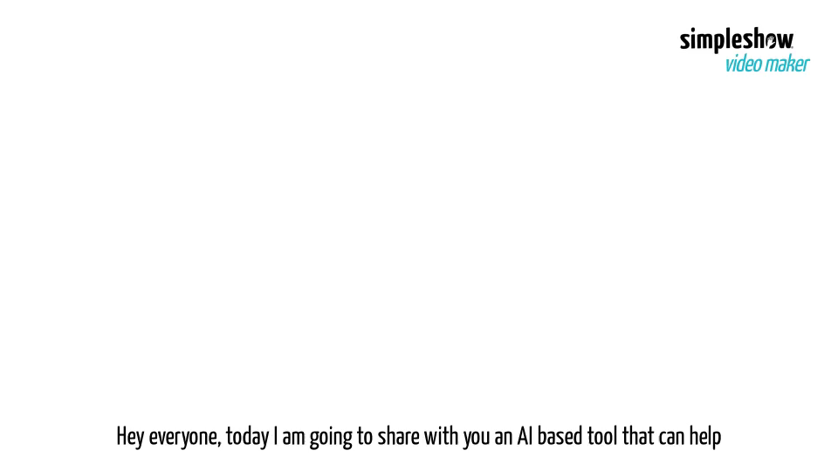
Background

Slide 4
Goals and Vision
Goals
Vision
To deliver a minimal viable product for feature detection of fundus images
The fundus feature detection tools can support the development of other AI-based diagnostic support system for use in clinics and hospital

Slide 5
Global disease burden
2.2 billion people with a near or distance vision impairment
At least 1 billion of these cases could have been prevented, or has yet to be addressed
In low-income and middle-income regions is estimated to be 4 times higher than in high-income regions
Population growth and ageing are expected to increase the risk

Slide 6
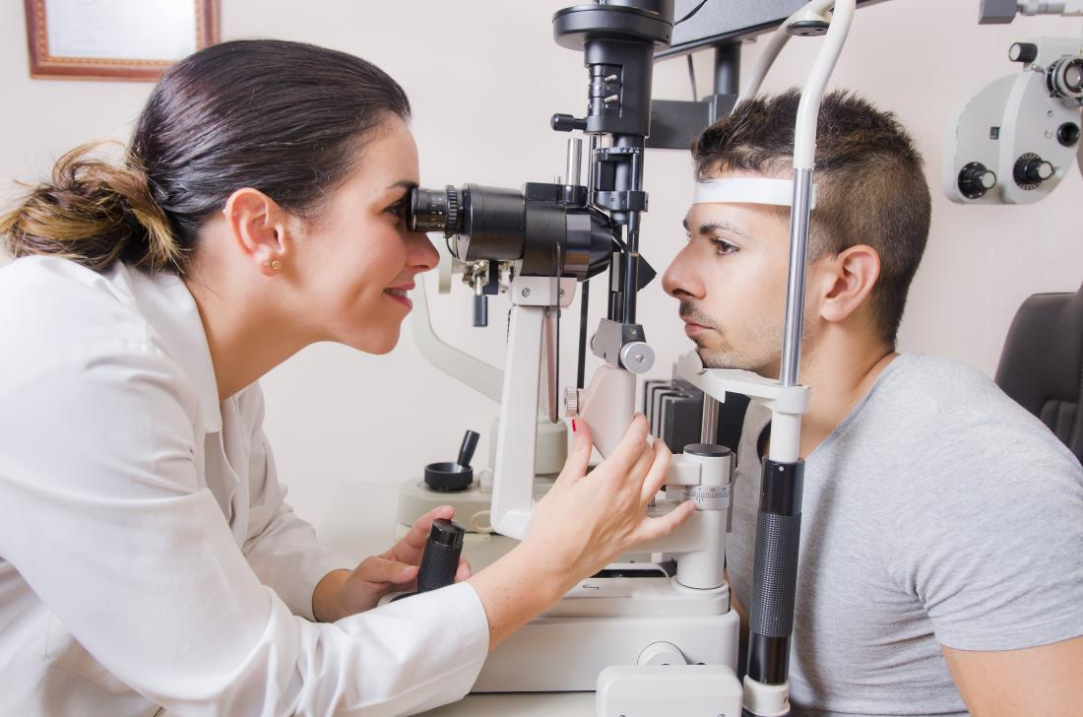
Problem Statement
Ophthalmology is high volume medical specialty that requires specialized physician domain knowledge and expensive equipment
Accentuated by an increased eye care burden from an ageing population

Slide 7
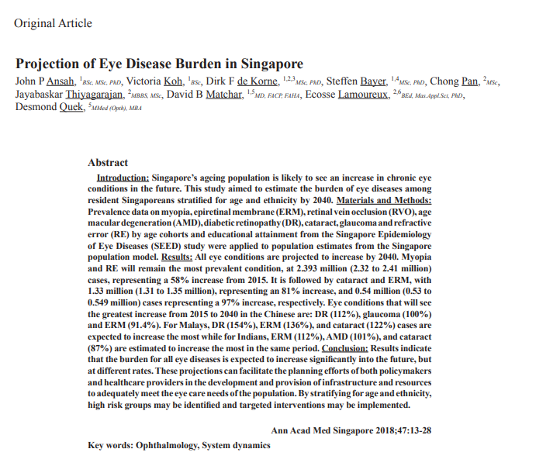
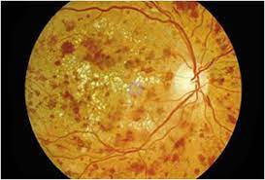
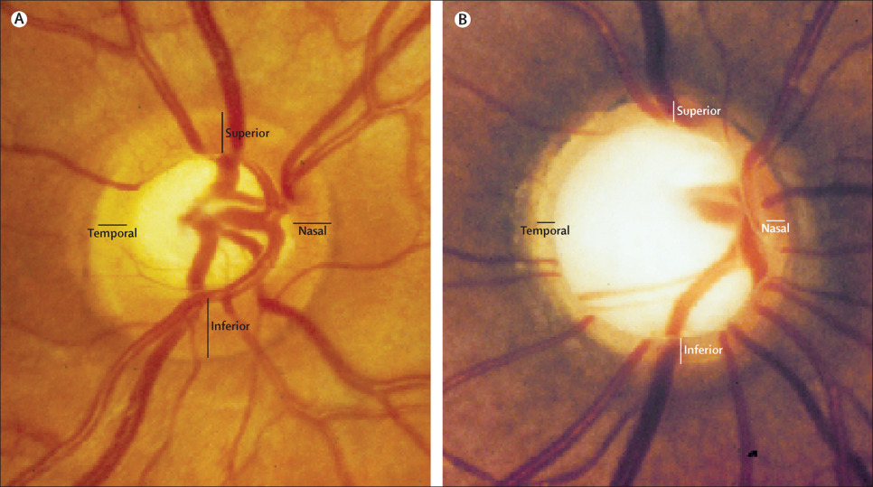
Eye burden in Singapore

Slide 8
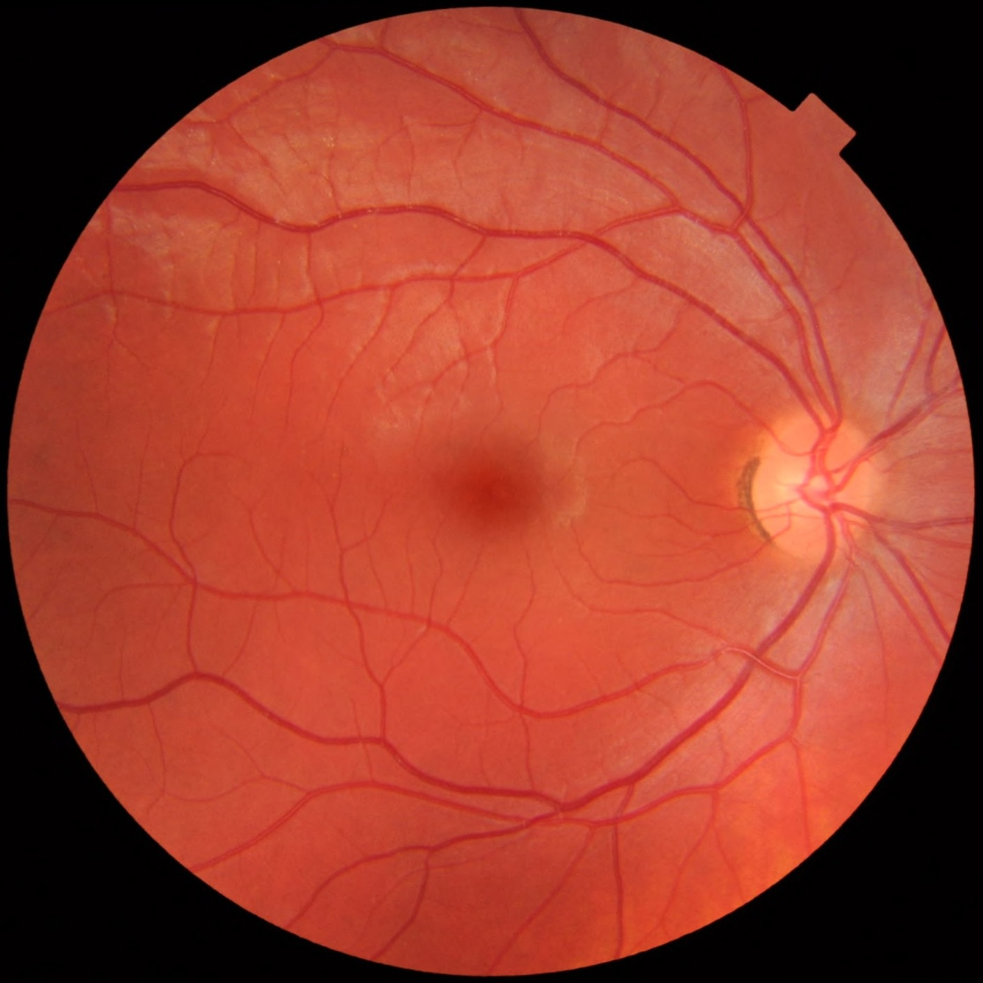
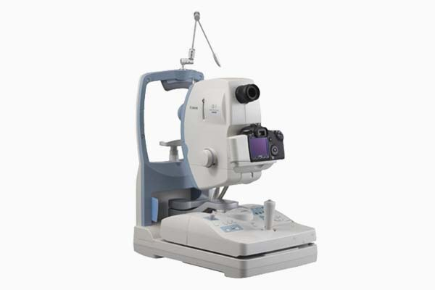


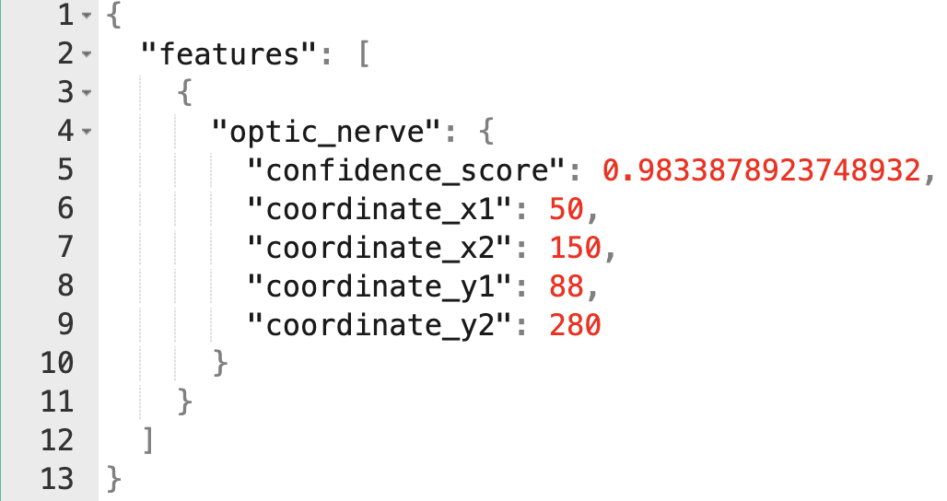
Goals
To deliver a minimal viable product for feature detection of fundus images
BV (0.7)
Optic Nerve (0.95)
Lens (0.8)
BV (0.7)
Digital Retinal Camera
Web Application
Pattern Recognition System
BV (0.7)
Feature Annotation

Slide 9
Goals
Input
Segmentation
Class Label
Class A
Class B
Class C
Class D
Class E

Slide 10
Project Plan

Slide 11
Software Development Process
Data acquisition
Obtain full fundus image from public domain, legally
Approaches
Data creation + augmentation
Create a set image subset of various fundus image feature
Random Forest Classifier
SVM
K-NN
LDA
Deep Neural Networks
Develop ML model for pattern recognition
Ensure that the system met the needs and requirement of Product Owner
Validate with Product Owner
Revise and Improve
Integrate ML/AI system into a software application for user to interact with the ML system
Software integration
Delivery
Delivery of final ML system and Project Report

Slide 12
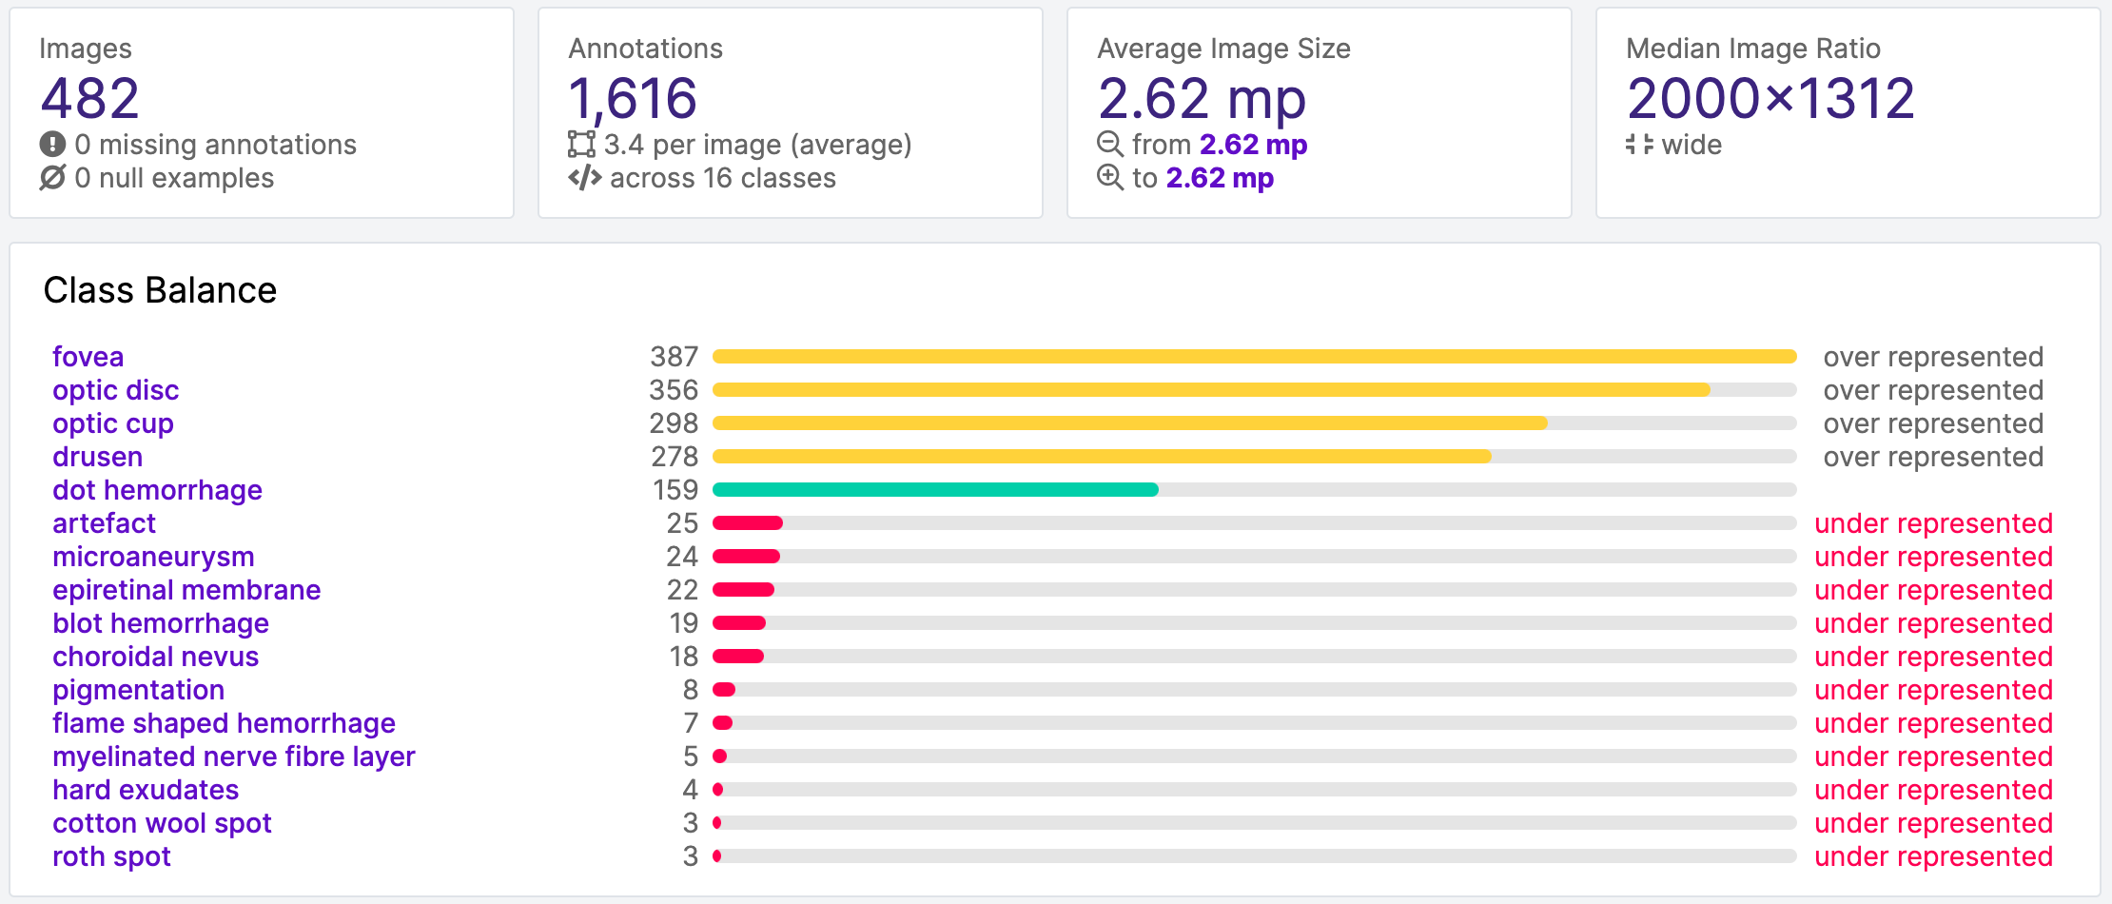
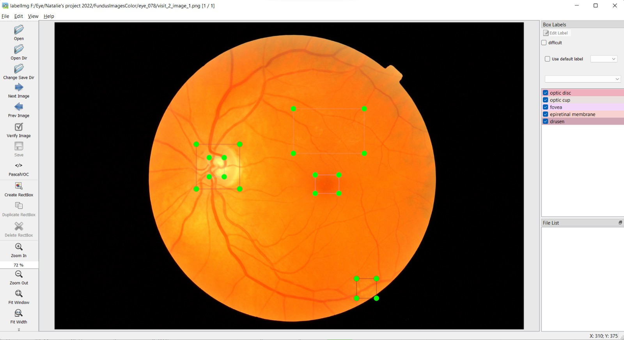
Data Collection and Labelling
Data acquisition and data health check
Fundus image acquire from public data set (Rotterdam Eye)
Manual labelling of data by domain expert (Kelvin Li)
A total of 482 images and 1616 annotations
Unbalanced data set
Fovea, optic disc, optic cup, drusen, dot hemorrhage are the most common class
Use LabelImg to label data for object detection

Slide 13
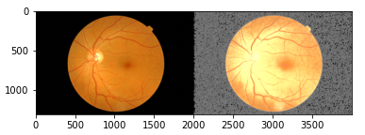
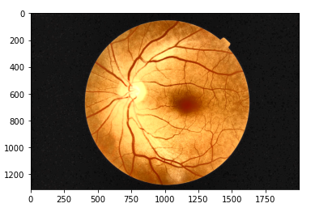
Image Pre-processing
We explored below pre-processing methods
Resize
Normalization
Black area re-fill
Histogram Equalization
CLANE Histogram Equalization
Example of Histogram Normalization
With image preprocessing resizing and normalization, model accuracy perform better.
Example of CLANE adjusted image

Slide 14
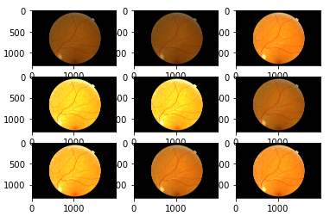
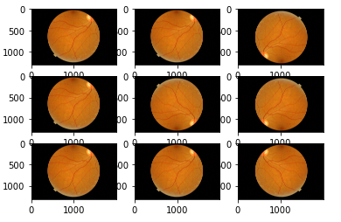
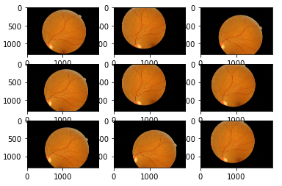
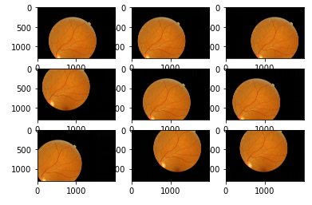
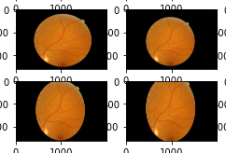
Image Augmentation
Use Keras <ImageDataGenerator> to realize
To Increase sample size and enhance model generalization
Flip.
Rotate.
Color Space/Brightness.
Shift.
Zoom.
Brightness
Flip
Rotation
Shift
Zoom

Slide 15
Data and Tools Requirement
Training and Test data availability
Datasets | Data size | Source | Available
Rotterdam Ophthalmic Data Repository | 70 | rodrep.com/data-sets.html | Yes

Slide 16
Data and Tools Requirement
Machine Learning tools and techniques used
Tools
Techniques
Tool | Purpose | Available
ImgLabel | Label training data | Yes
Roboflow | Data preprocessing | Yes
Scikit-Learn | Machine Learning Library | Yes
Keras | Deep Learning Library | Yes
PyTorch | Deep Learning Library | Yes
Python | Programming Language | Yes
Google CoLab | Training Models and project collaboration | Yes
Random Forest Classifier
SVM
K-NN
LDA
Deep Neural Networks

Slide 17
Data and Tools Requirement
Software Development tools and availability
Tool | Purpose | Available
Visual Studio Code | Development Environment | Yes
Python / JavaScript | Programming Language | Yes
Angular 8 | Web UI Framework | Yes
Flask | Python-based Web Server | Yes
Jetty 8 | Web Container Server | Yes
Hardware requirements and availability
Tool | Purpose | Available
Personal Laptop | Development and Demonstration | Yes

Slide 18
Progress Update
Fundus data set (16 classes)
Under-Represented (11)
Over-Represented (5)
artefact
microaneurysm
epiretinal membrane
dot hemorrhage
chorodial nevus
pigmentation
flame shaped hemorrhage
myelinated nerve fibre layer
hard exudates
cotton wool spot
roth spot
fovea
optic cup
optic disc
drusen
dot hemorrhage

Slide 19
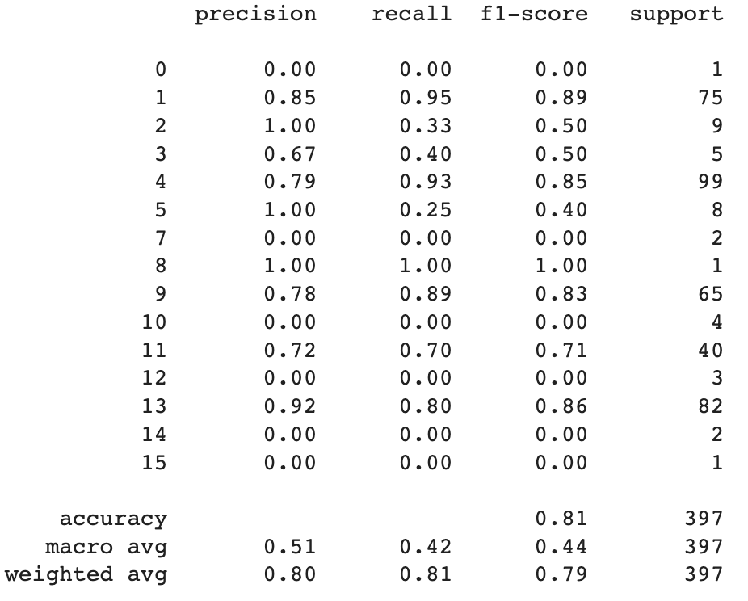
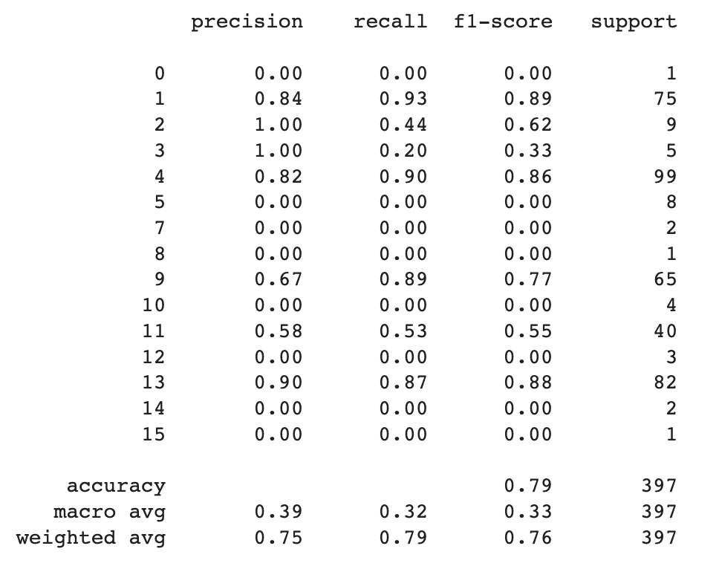
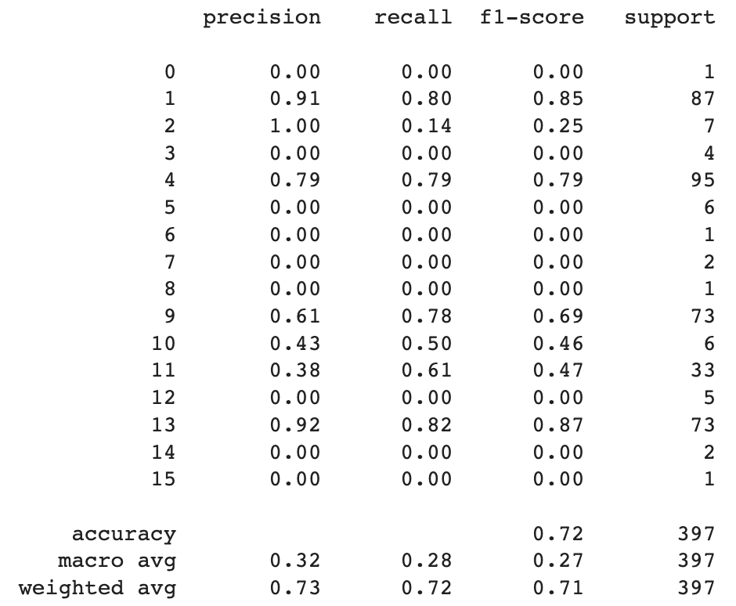
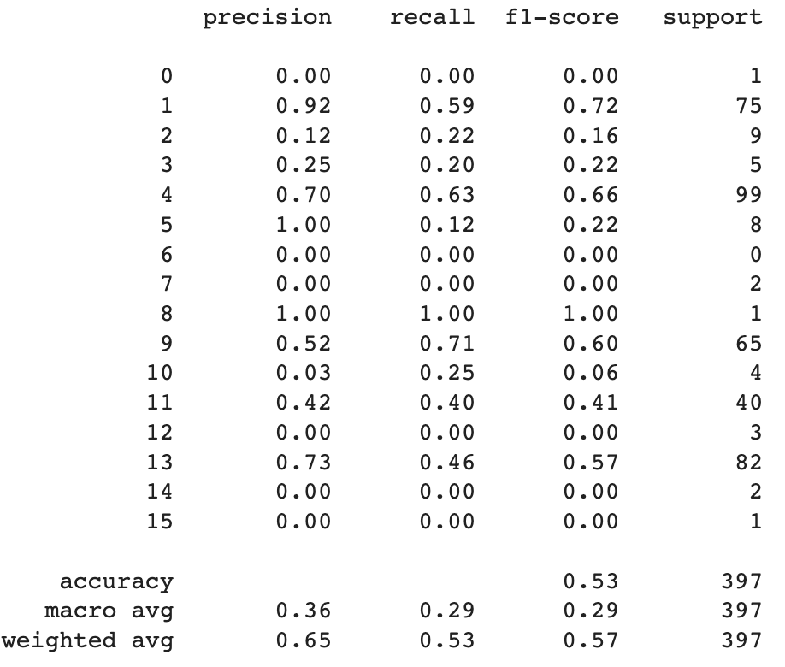
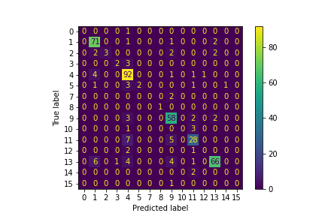
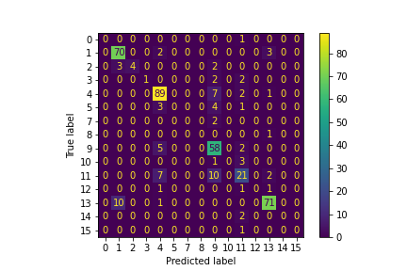
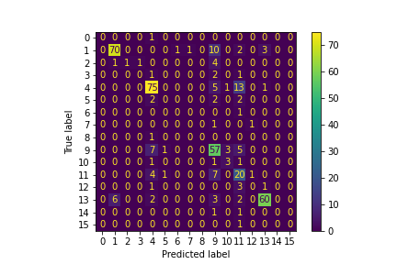
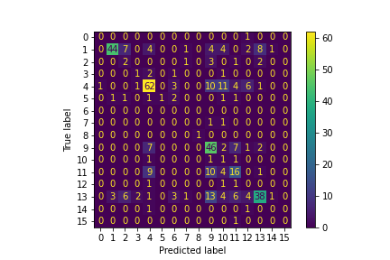
Progress Update
Support Vector Machine
Random Forest Classifier
K-Nearest Neigbour
LDA Classifier
optic disc
fovea
blot hemorrhage

Slide 20
Progress Update
 | Support Vector Machine |  | Random Forest Classifier |  | K-Nearest Neigbour |  | LDA Classifier
 | Train AUC | Test AUC | Train AUC | Test AUC | Train AUC | Test AUC | Train AUC | Test AUC
Roth spot | 0.65 | 0.59 | 0.16 | 0.60 | 0.39 | 0.37 | 0.01 | 0.09
Optic disc | 0.99 | 0.98 | 1.00 | 0.97 | 1.00 | 0.95 | 1.00 | 0.87
artefact | 0.71 | 0.74 | 0.62 | 0.64 | 0.39 | 0.45 | 0.18 | 0.32
Choroidal nevus | 0.60 | 0.53 | 0.36 | 0.30 | 0.39 | 0.37 | 0.02 | 0.08
fovea | 0.12 | 0.14 | 0.16 | 0.16 | 0.36 | 0.34 | 0.21 | 0.35
Epiretrinal membrane | 0.65 | 0.63 | 0.41 | 0.46 | 0.39 | 0.37 | 0.02 | 0.43
Hard exudate | 0.64 | nan | 0.35 | Nan | 0.39 | 0.37 | 0.04 | Nan
Pigmentation | 0.67 | 0.51 | 0.24 | 0.31 | 0.39 | 0.37 | 0.01 | 0.62
Myelinated nerve fibre layer | 0.56 | 0.72 | 0.42 | 0.54 | 0.39 | 0.37 | 0.01 | 0.01
Drusen | 0.36 | 0.41 | 0.34 | 0.35 | 0.37 | 0.34 | 0.52 | 0.46
Microaneurysm | 0.50 | 0.51 | 0.27 | 0.31 | 0.39 | 0.37 | 0.34 | 0.59
Dot hemorrhage | 0.45 | 0.46 | 0.30 | 0.32 | 0.38 | 0.37 | 0.55 | 0.51
Blot hemorrhage | 0.41 | 0.49 | 0.44 | 0.49 | 0.39 | 0.37 | 0.17 | 0.55
Optic cup | 0.49 | 0.52 | 0.64 | 0.70 | 0.37 | 0.46 | 0.41 | 0.42
Flame shaped hemorrhage | 0.51 | 0.41 | 0.45 | 0.28 | 0.39 | 0.37 | 0.01 | 0.41
Cotton wool spot | 0.75 | 0.69 | 0.74 | 0.44 | 0.39 | 0.37 | 0.01 | 0.67

Slide 21
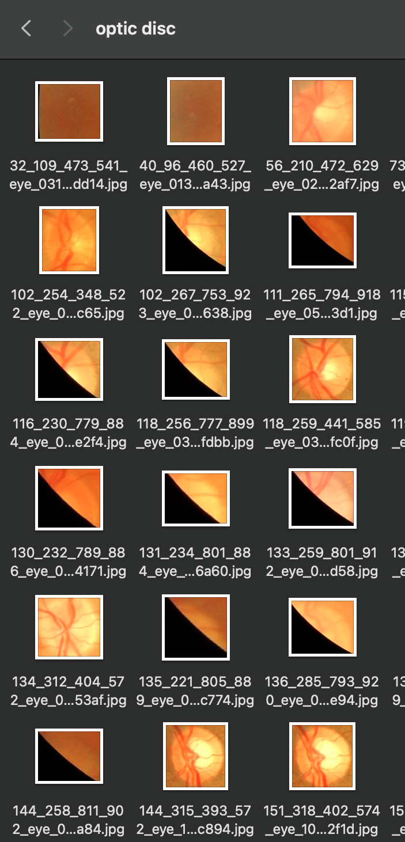
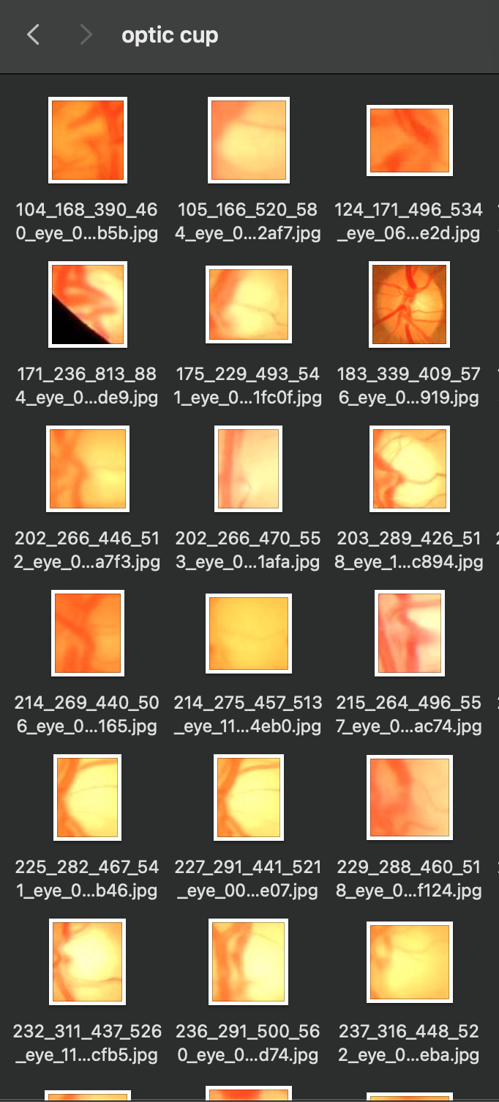
Progress Update
Unrelated feature resulting in classification bias
Sample of ”optic disc”
Sample of ”optic cup”

Slide 22
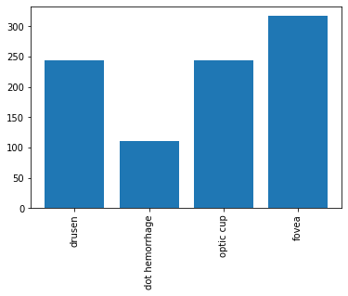
Progress Update
Labels of overrepresented data

Slide 23
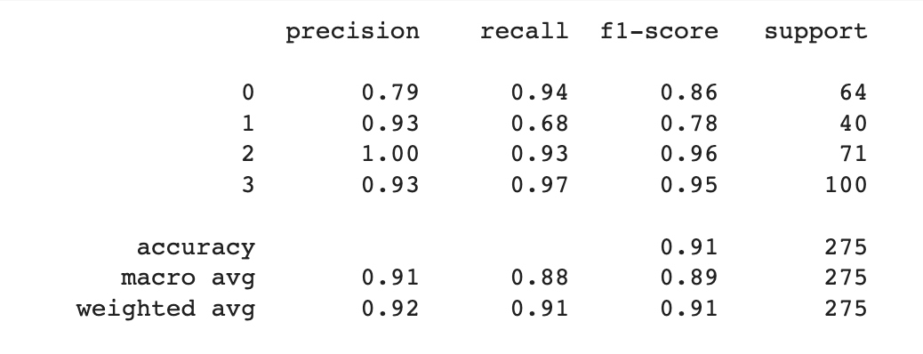
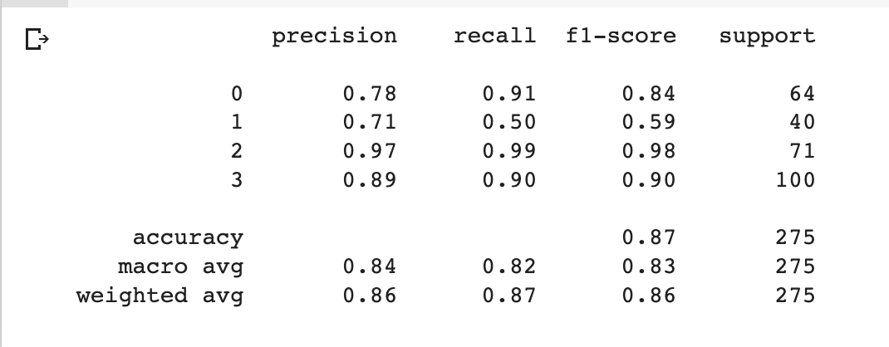
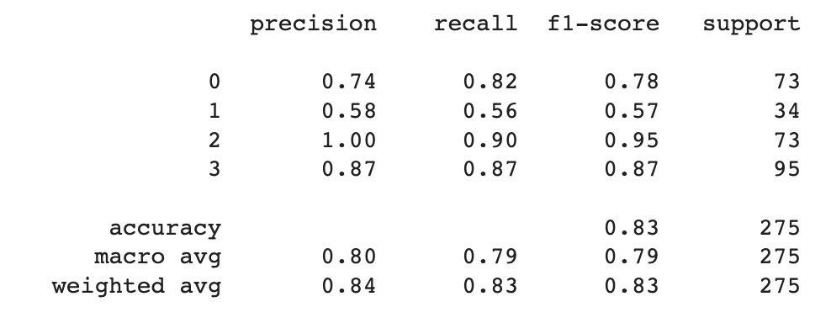
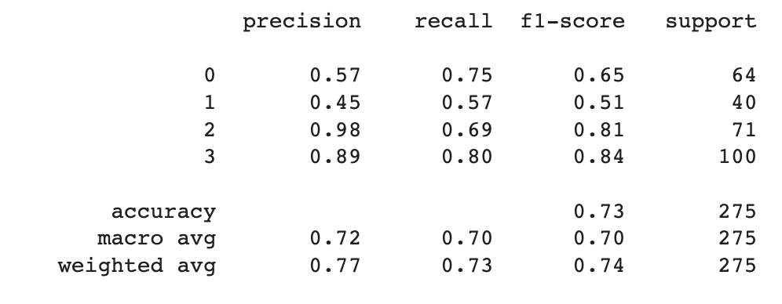
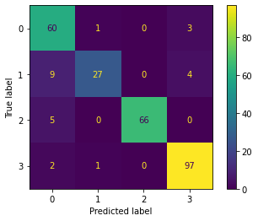
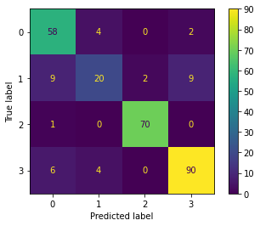
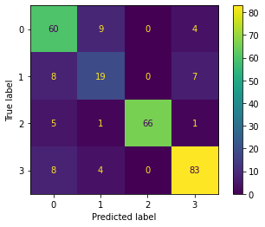
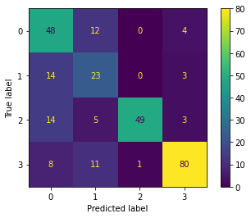
Progress Update
Support Vector Machine
Random Forest Classifier
K-Nearest Neigbour
LDA Classifier
optic cup
fovea

Slide 24
Progress Update
 | Support Vector Machine |  | Random Forest Classifier |  | K-Nearest Neigbour |  | LDA Classifier
 | Train AUC | Test AUC | Train AUC | Test AUC | Train AUC | Test AUC | Train AUC | Test AUC
Drusen | 0.49 | 0.47 | 0.50 | 0.50 | 0.42 | 0.51 | 0.61 | 0.59
Dot hemorrhage | 0.99 | 0.96 | 1 | 0.94 | 1 | 0.88 | 1 | 0.84
Optic cup | 0.13 | 0.07 | 0.2 | 0.09 | 0.42 | 0.37 | 0.0 | 0.17
fovea | 0.62 | 0.64 | 0.54 | 0.61 | 0.41 | 0.42 | 0.42 | 0.51

Slide 25
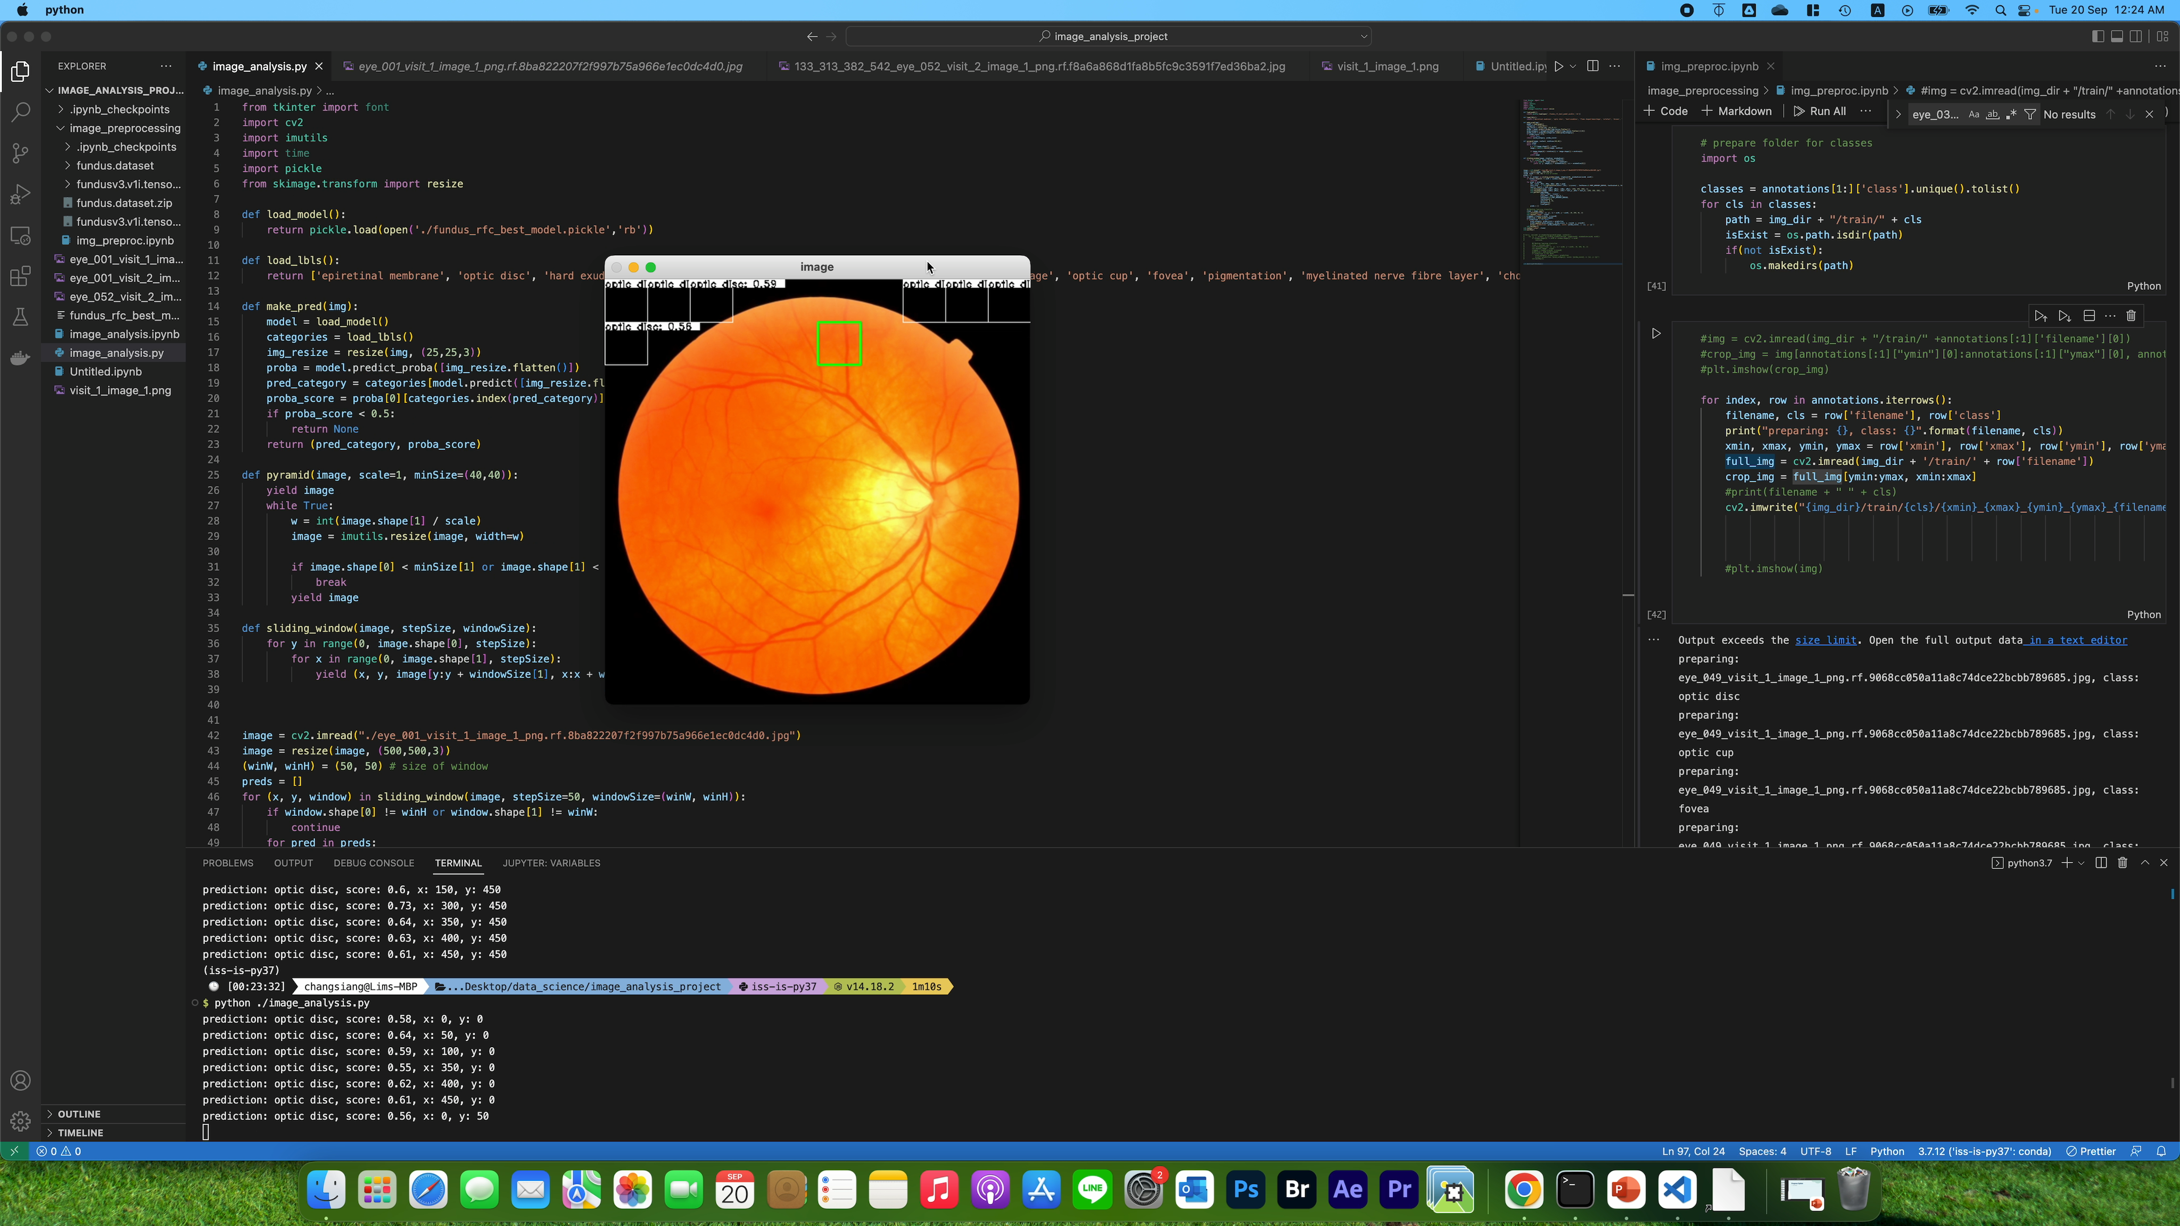
Progress Update
Created a simple sliding box approach for bounding box detection using supervised learning model
The detection speed is too slow
Time complexity increases with the size of the image
Need a better approach for bounding box detection

Slide 26
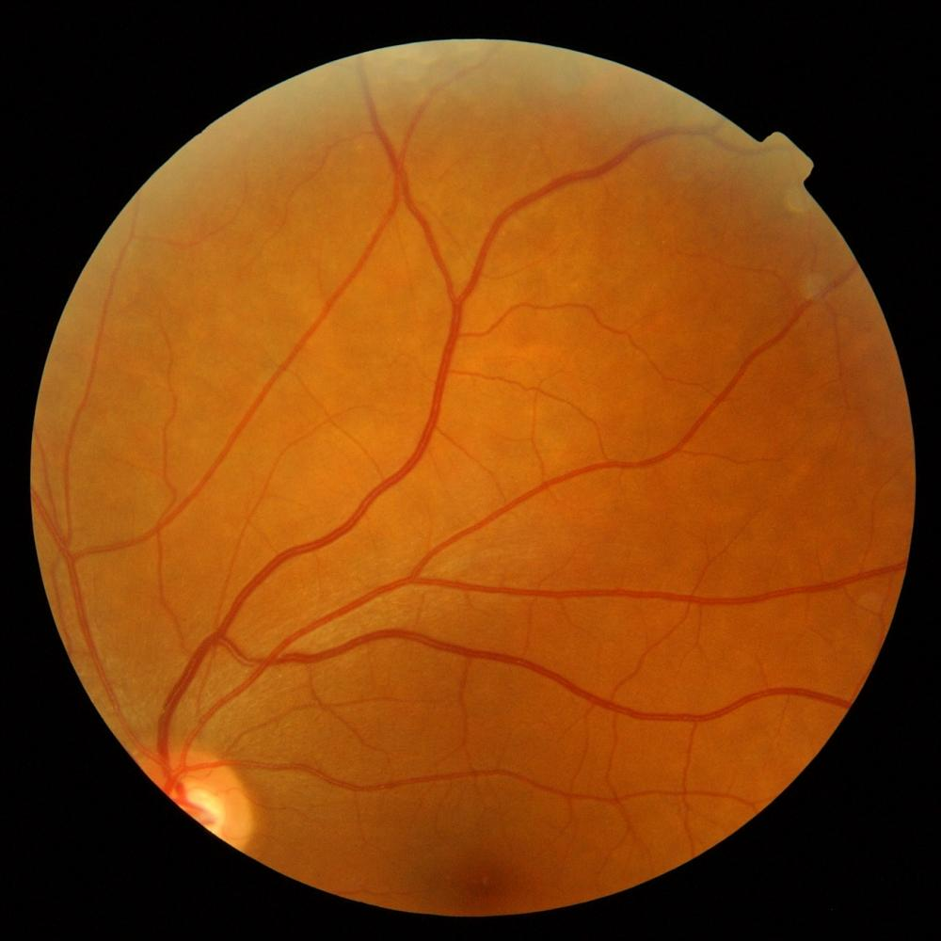
Progress Update
cls_predict(4)
Concatenation
Input (512, 512, 3)
CNN-Based feature Extraction Model
Probability(1)
bbox (4)

Slide 27
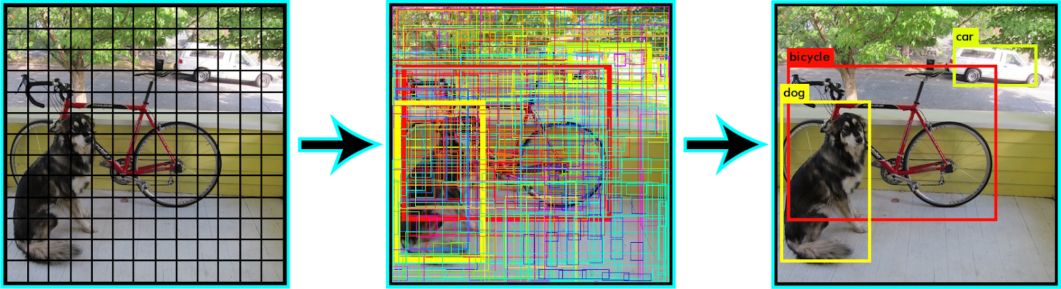
Progress Update
Illustration of YOLO approach

Slide 28
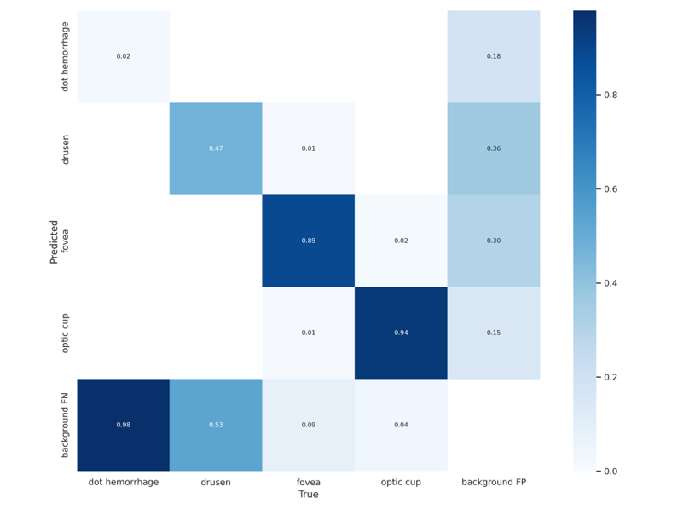
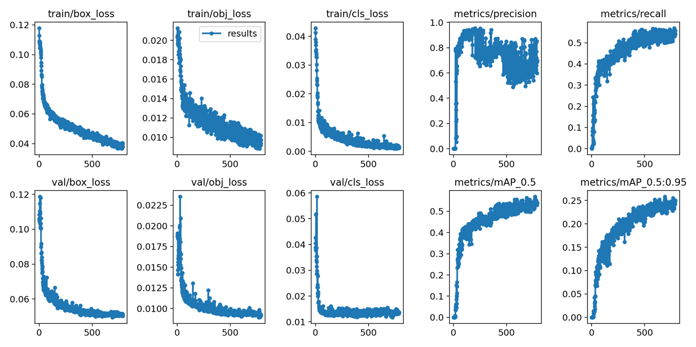
Progress Update
YOLOv5 Training Results

Slide 29
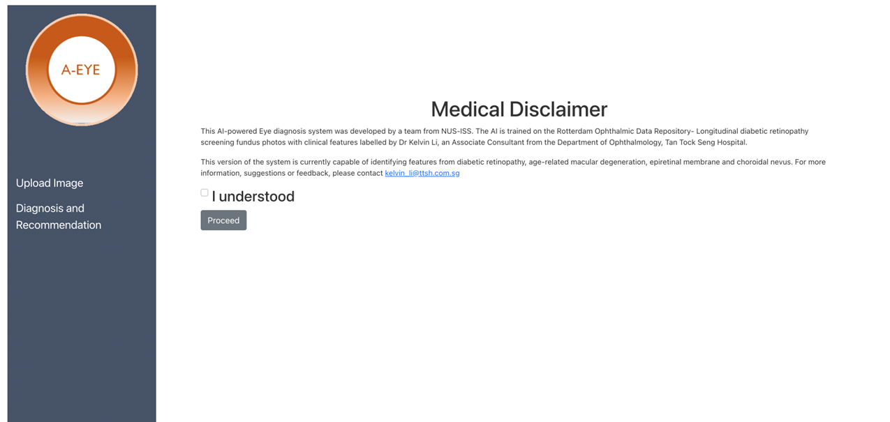
System Demo

Slide 30
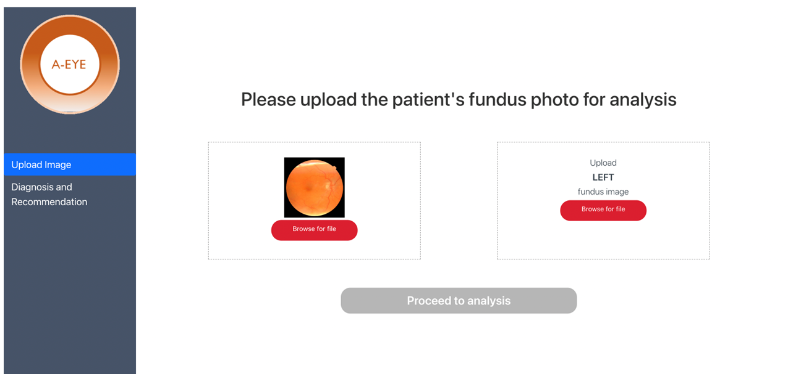
System Demo

Slide 31
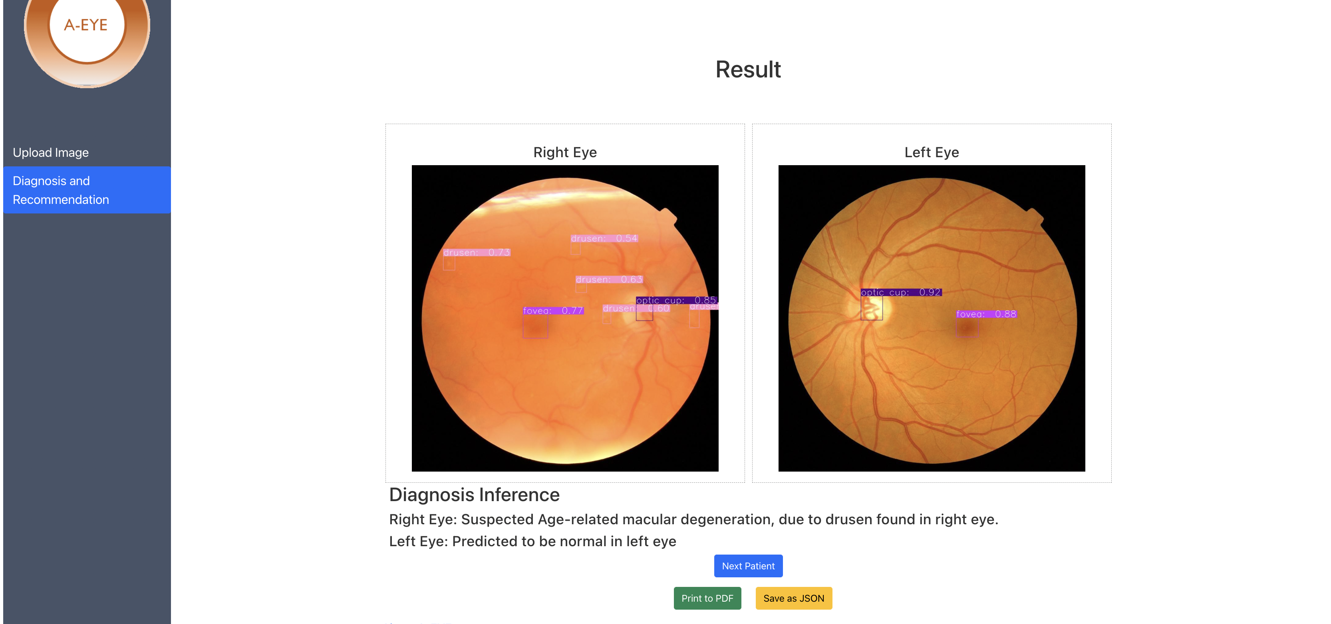
System Demo
Training and Validation loss

Slide 32
Progress Overview
Data sourcing, preparation and labeling
UI Design
Data pre-processing
Build prediction model using different approach
Develop bbox approach
Attempt transfer learning approach
System integration
Demo Testing
Presentation video recording
Final Report

Slide 33
Summary
Final project report submission
Final Video submission
Final presentation submission
Integrated system
Improve on classification on more features
Further investigate on management plan for patient

Slide 34
Thank You!
Do you have any questions?

